Slide 1



Life Expectancy Analysis
Monish Kamal Bathini

Slide 2
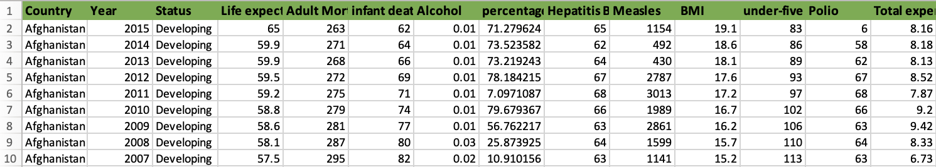
Introduction
Life expectancy is a statistical measure indicating the average time a person is expected to live. It's typically calculated at birth and is influenced by various factors such as healthcare, genetics, and socio-economic conditions. It's an essential indicator of healthcare, education population's health
Variables
Resposnse Variable ~ Y is Life Expectancy.
Predictor Variables ~ Xi are Country, Year, Status, Life Expectancy, Adult Mortality, Infant Deaths, Alcohol, Percentage Expenditure, Hepatitis B, Measles, BMI, Under-five deaths, Polio, Total expenditure, Diphtheria, HIV/AIDS, GDP, Population, thinness 1-19 years, thinness 5-9 years, Income composition of resources, Schooling.

Slide 3
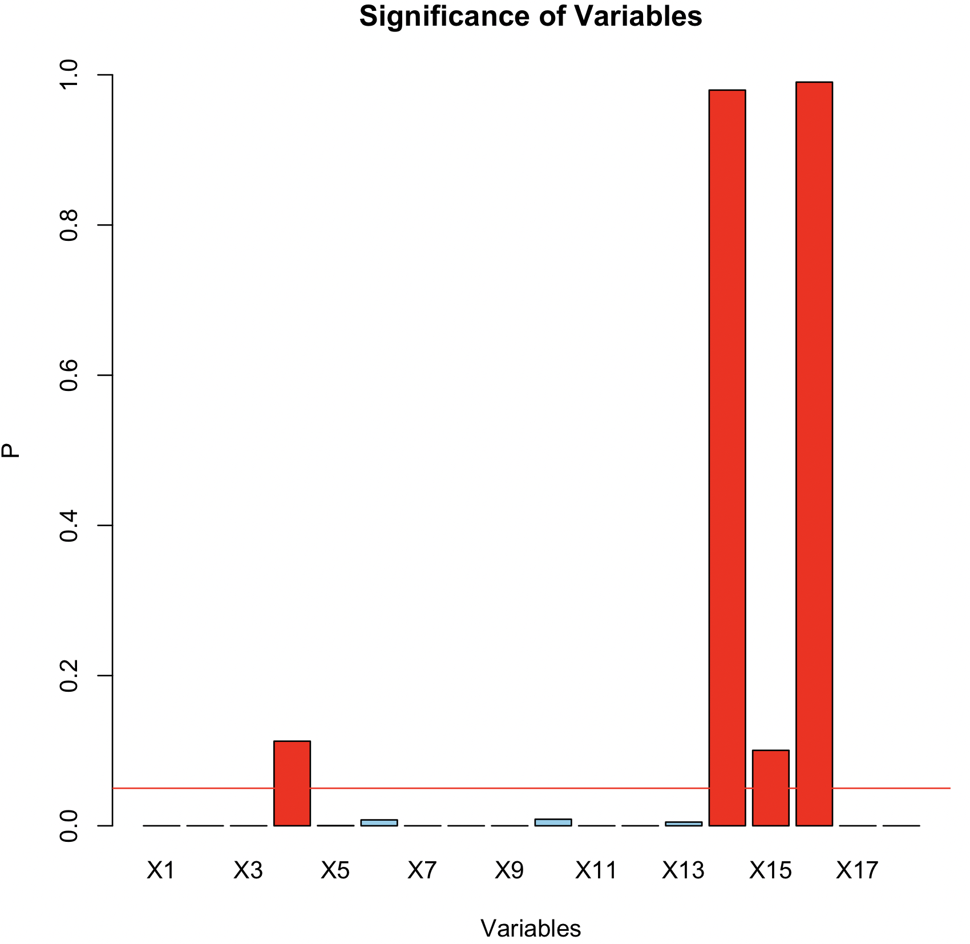
FUll Model:
Y = 54.54−0.02034×X1+0.09954×X2+0.1214×X3+0.0001341×X4−0.01412×X5−0.00002046×X6+0.0434×X7−0.07437×X8+
0.02875×X9+0.08911×X10+0.03967×X11−0.4715×X12+0.00003663×X13+0.00000000004337×X14−0.08324×X15+
0.0006069×X16+5.993×X17+0.6696×X18​
R2adj value is 0.8164
p-value(f) of the model < 2.2e-16
X3, X14, X15 are insignificant.

Slide 4
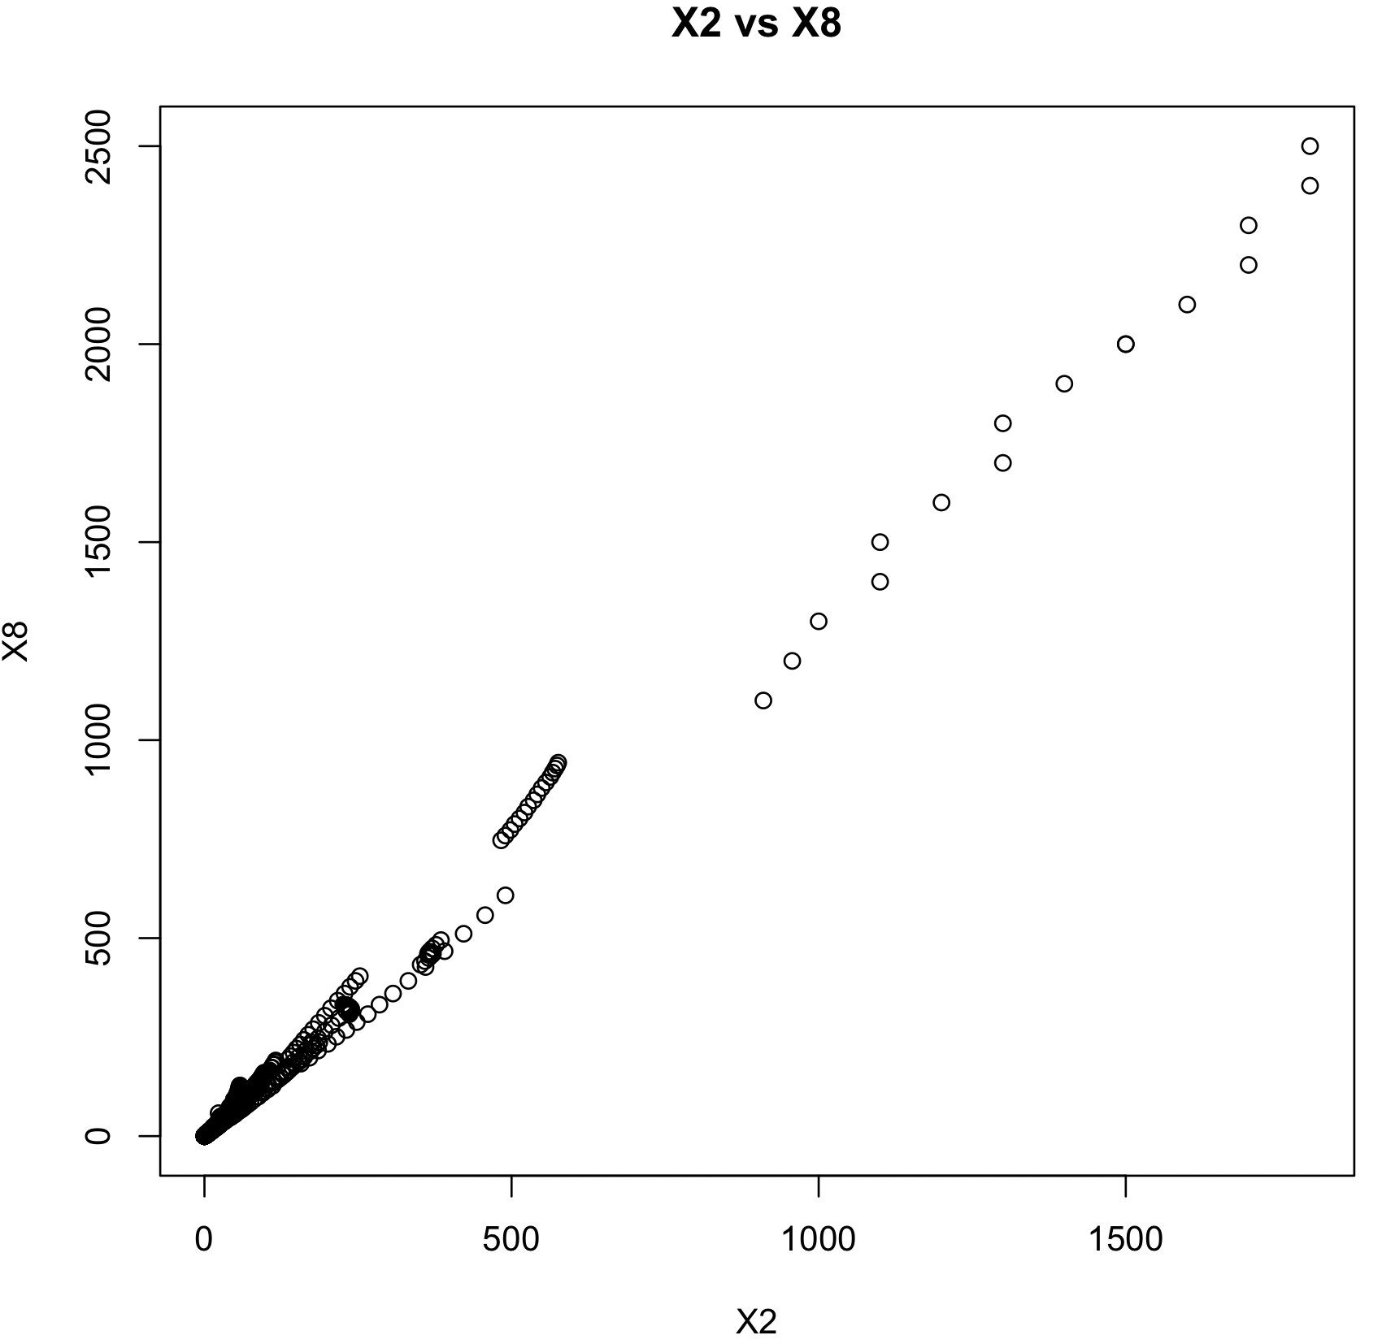
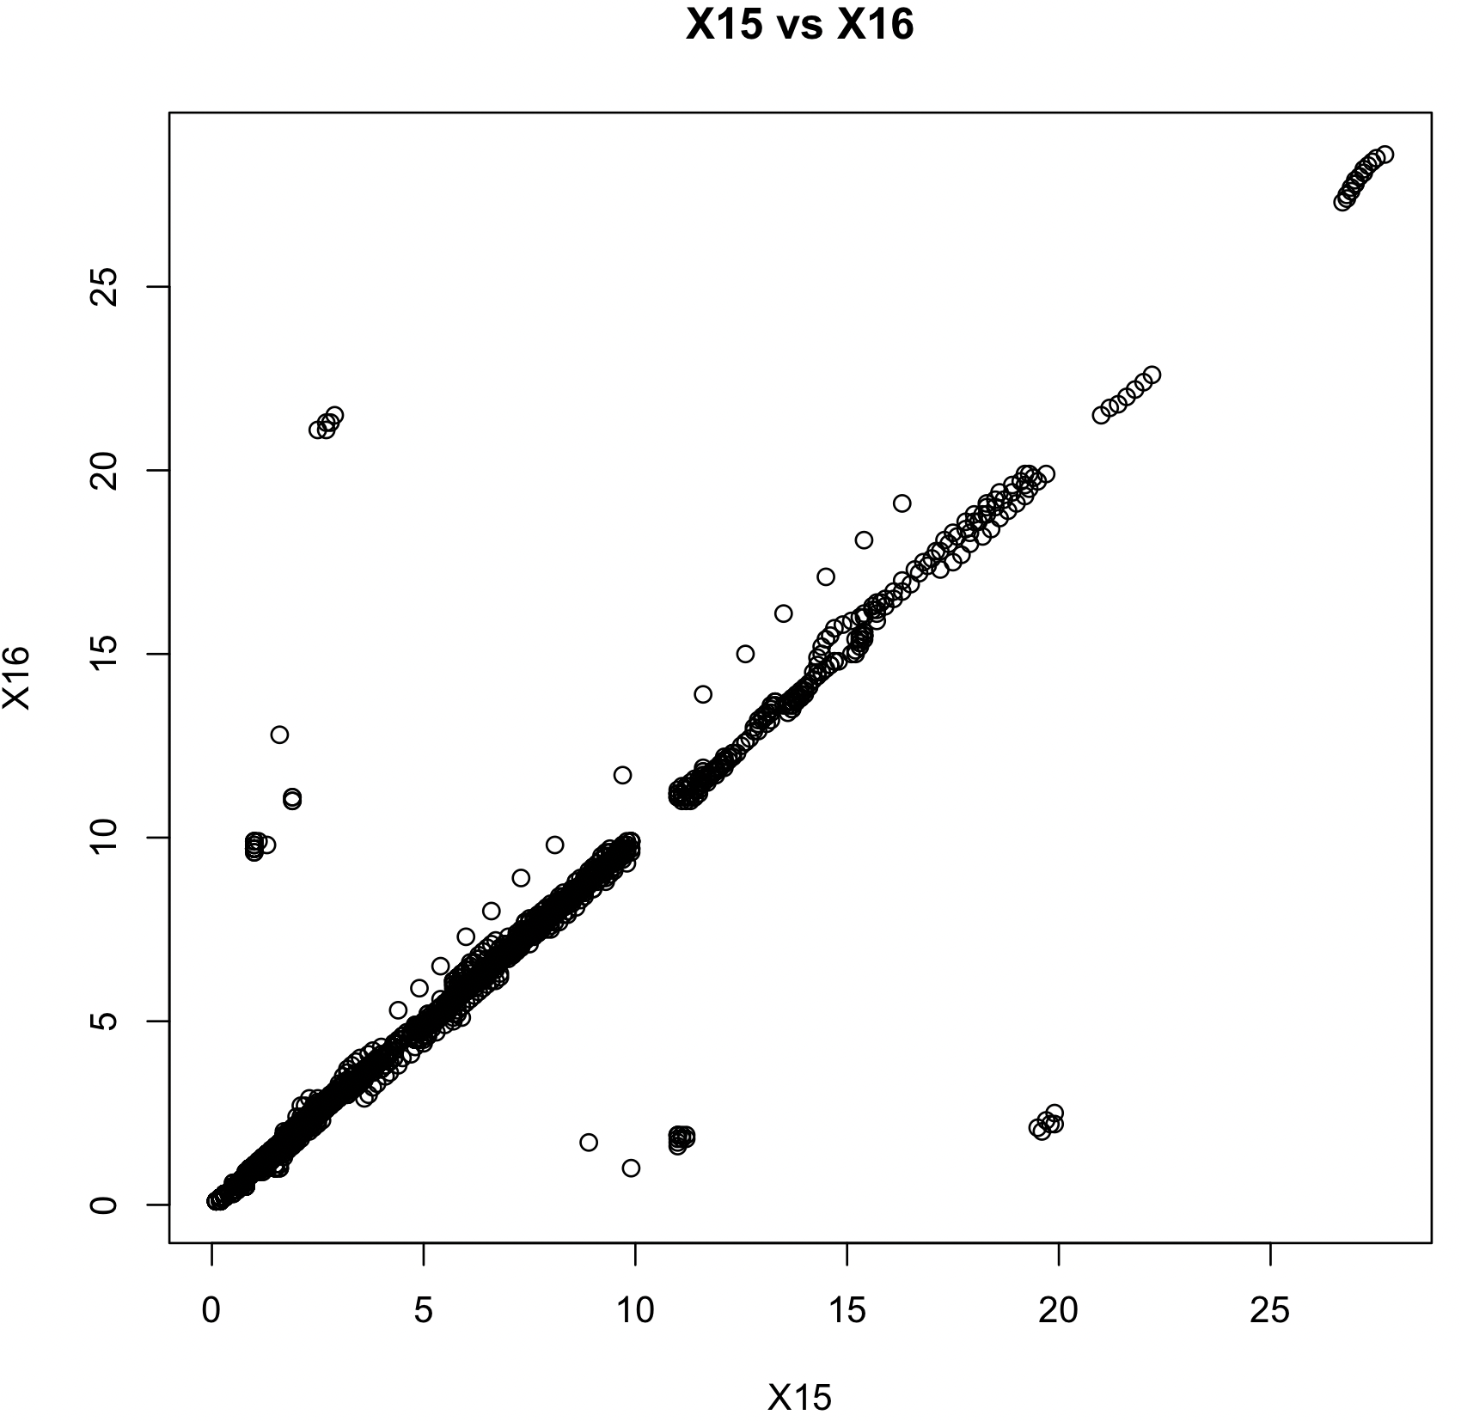
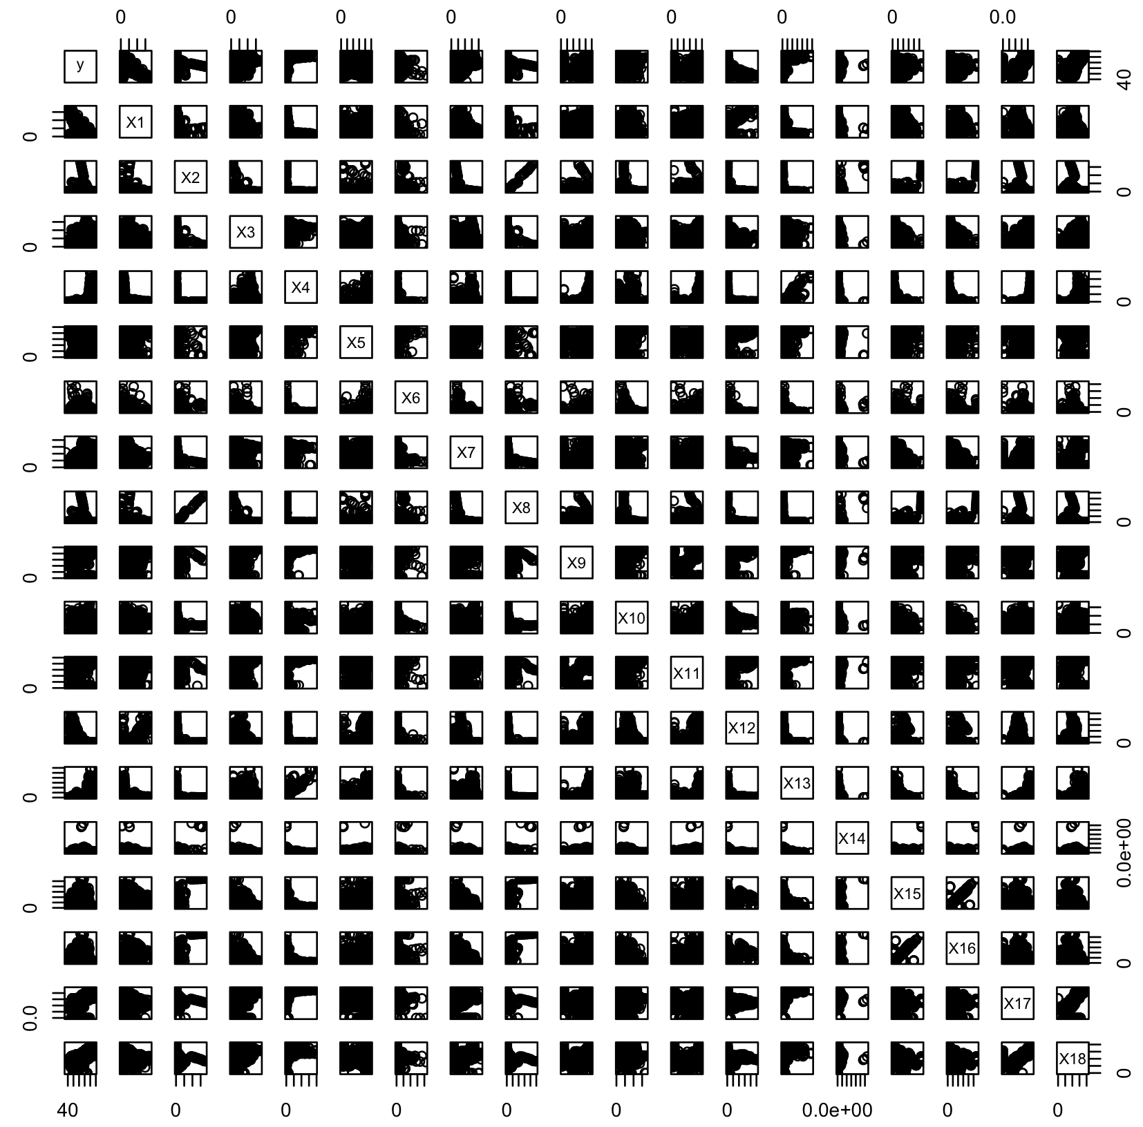
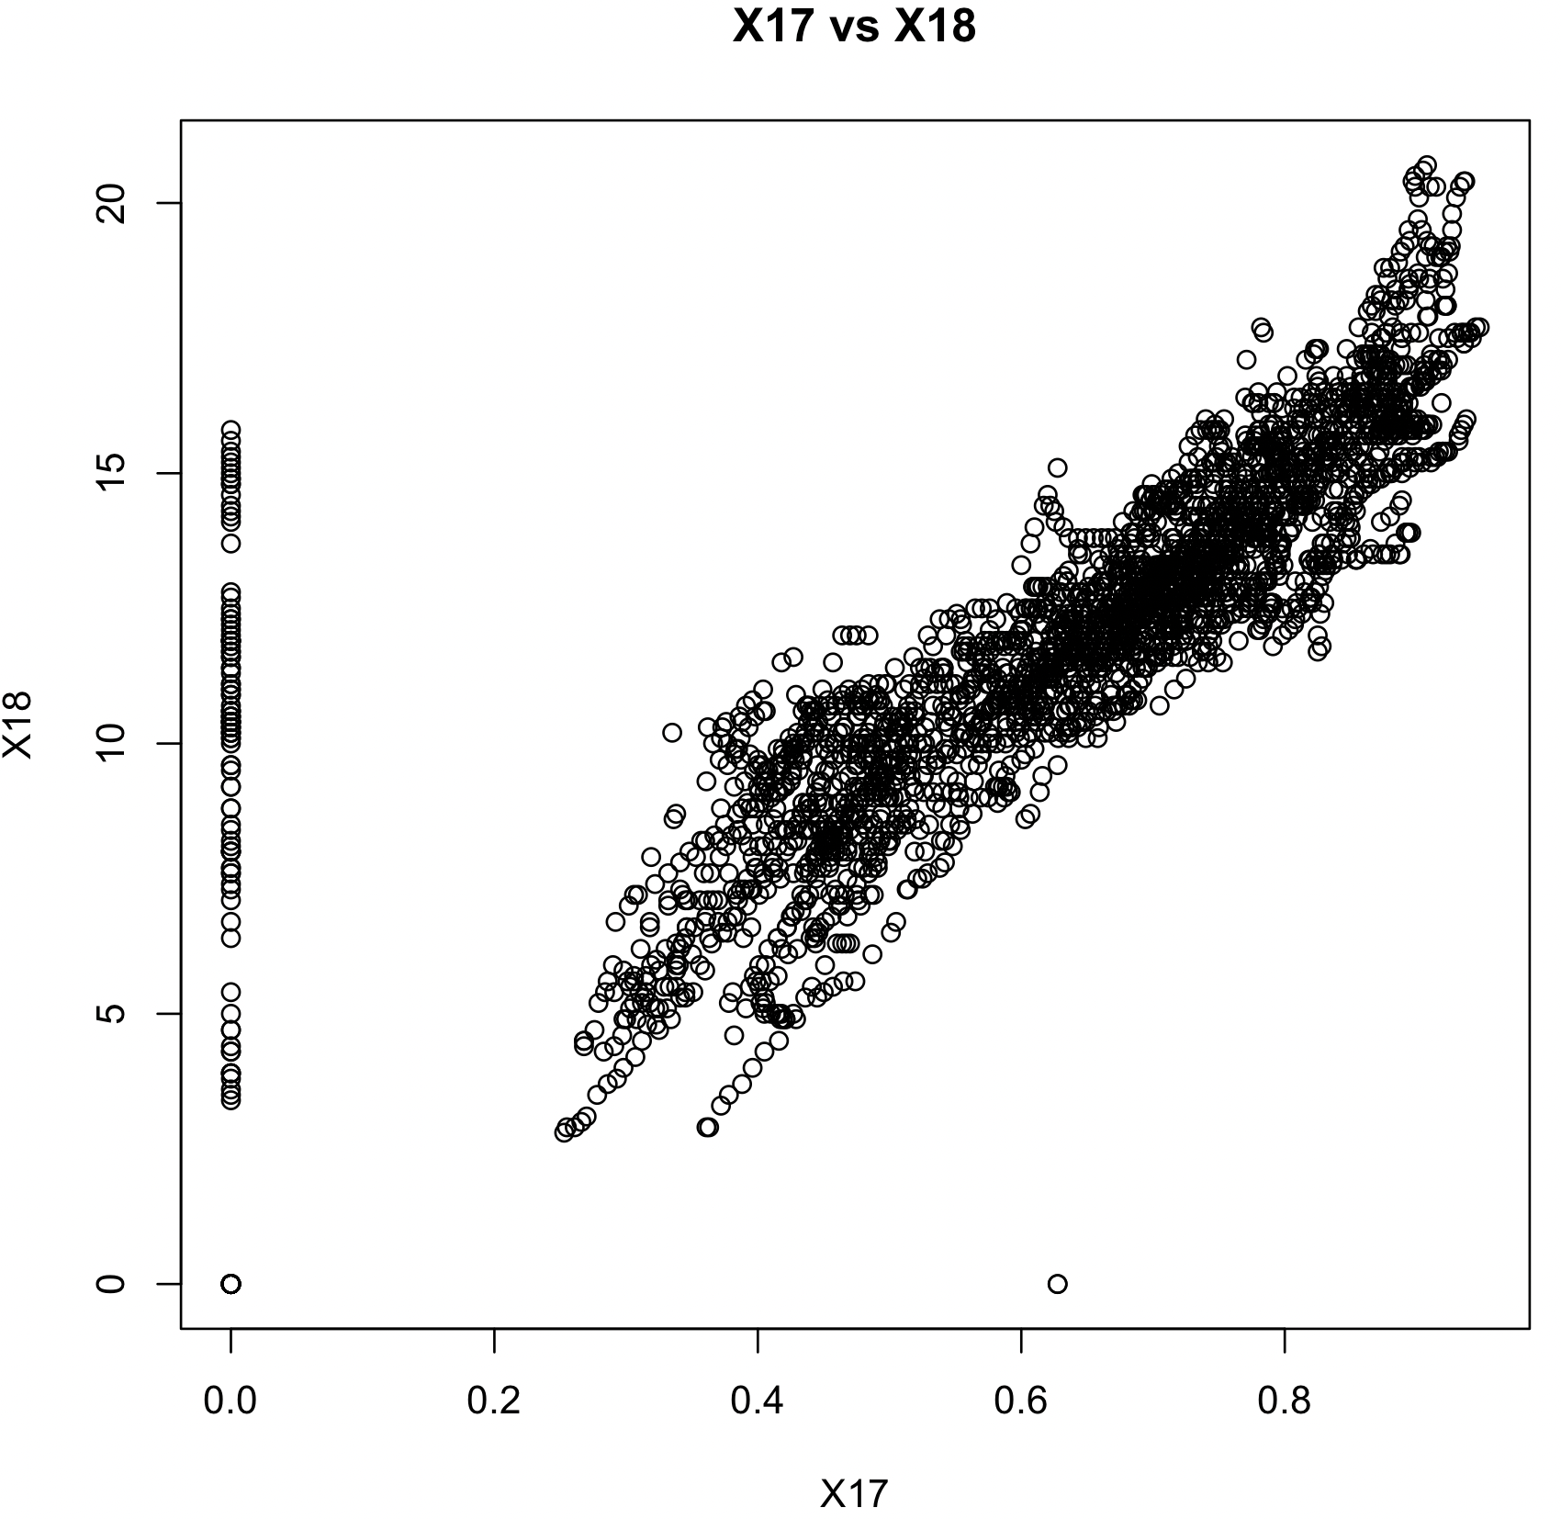
Multicollinearity
Summary:
X2, X8 are highly correlated.
X15, X16 are highly correlated.
X17, X18 are highly correlated.

Slide 5
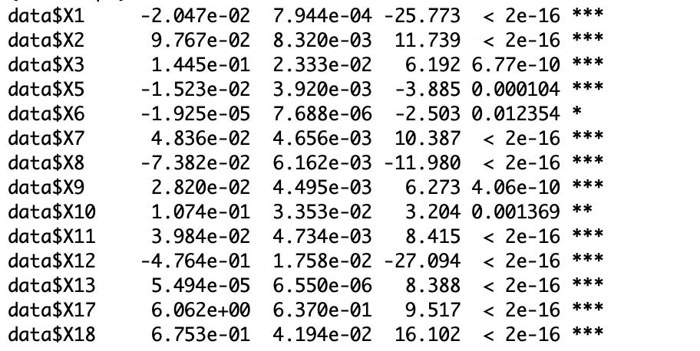
Reduced Model:
Y =54.20−0.02153×X1+0.09744×X2+0.1599×X3−0.01549×X5−0.00002401×X6−0.07422×X8+
0.02971×X9+0.149×X10+0.04051×X11−0.4901×X12+0.00005629×X13+6.750×X17+0.7371×X18
Summary:
R2adj value is 0.0.8158
p-value(f) of the model < 2.2e-16

Slide 6
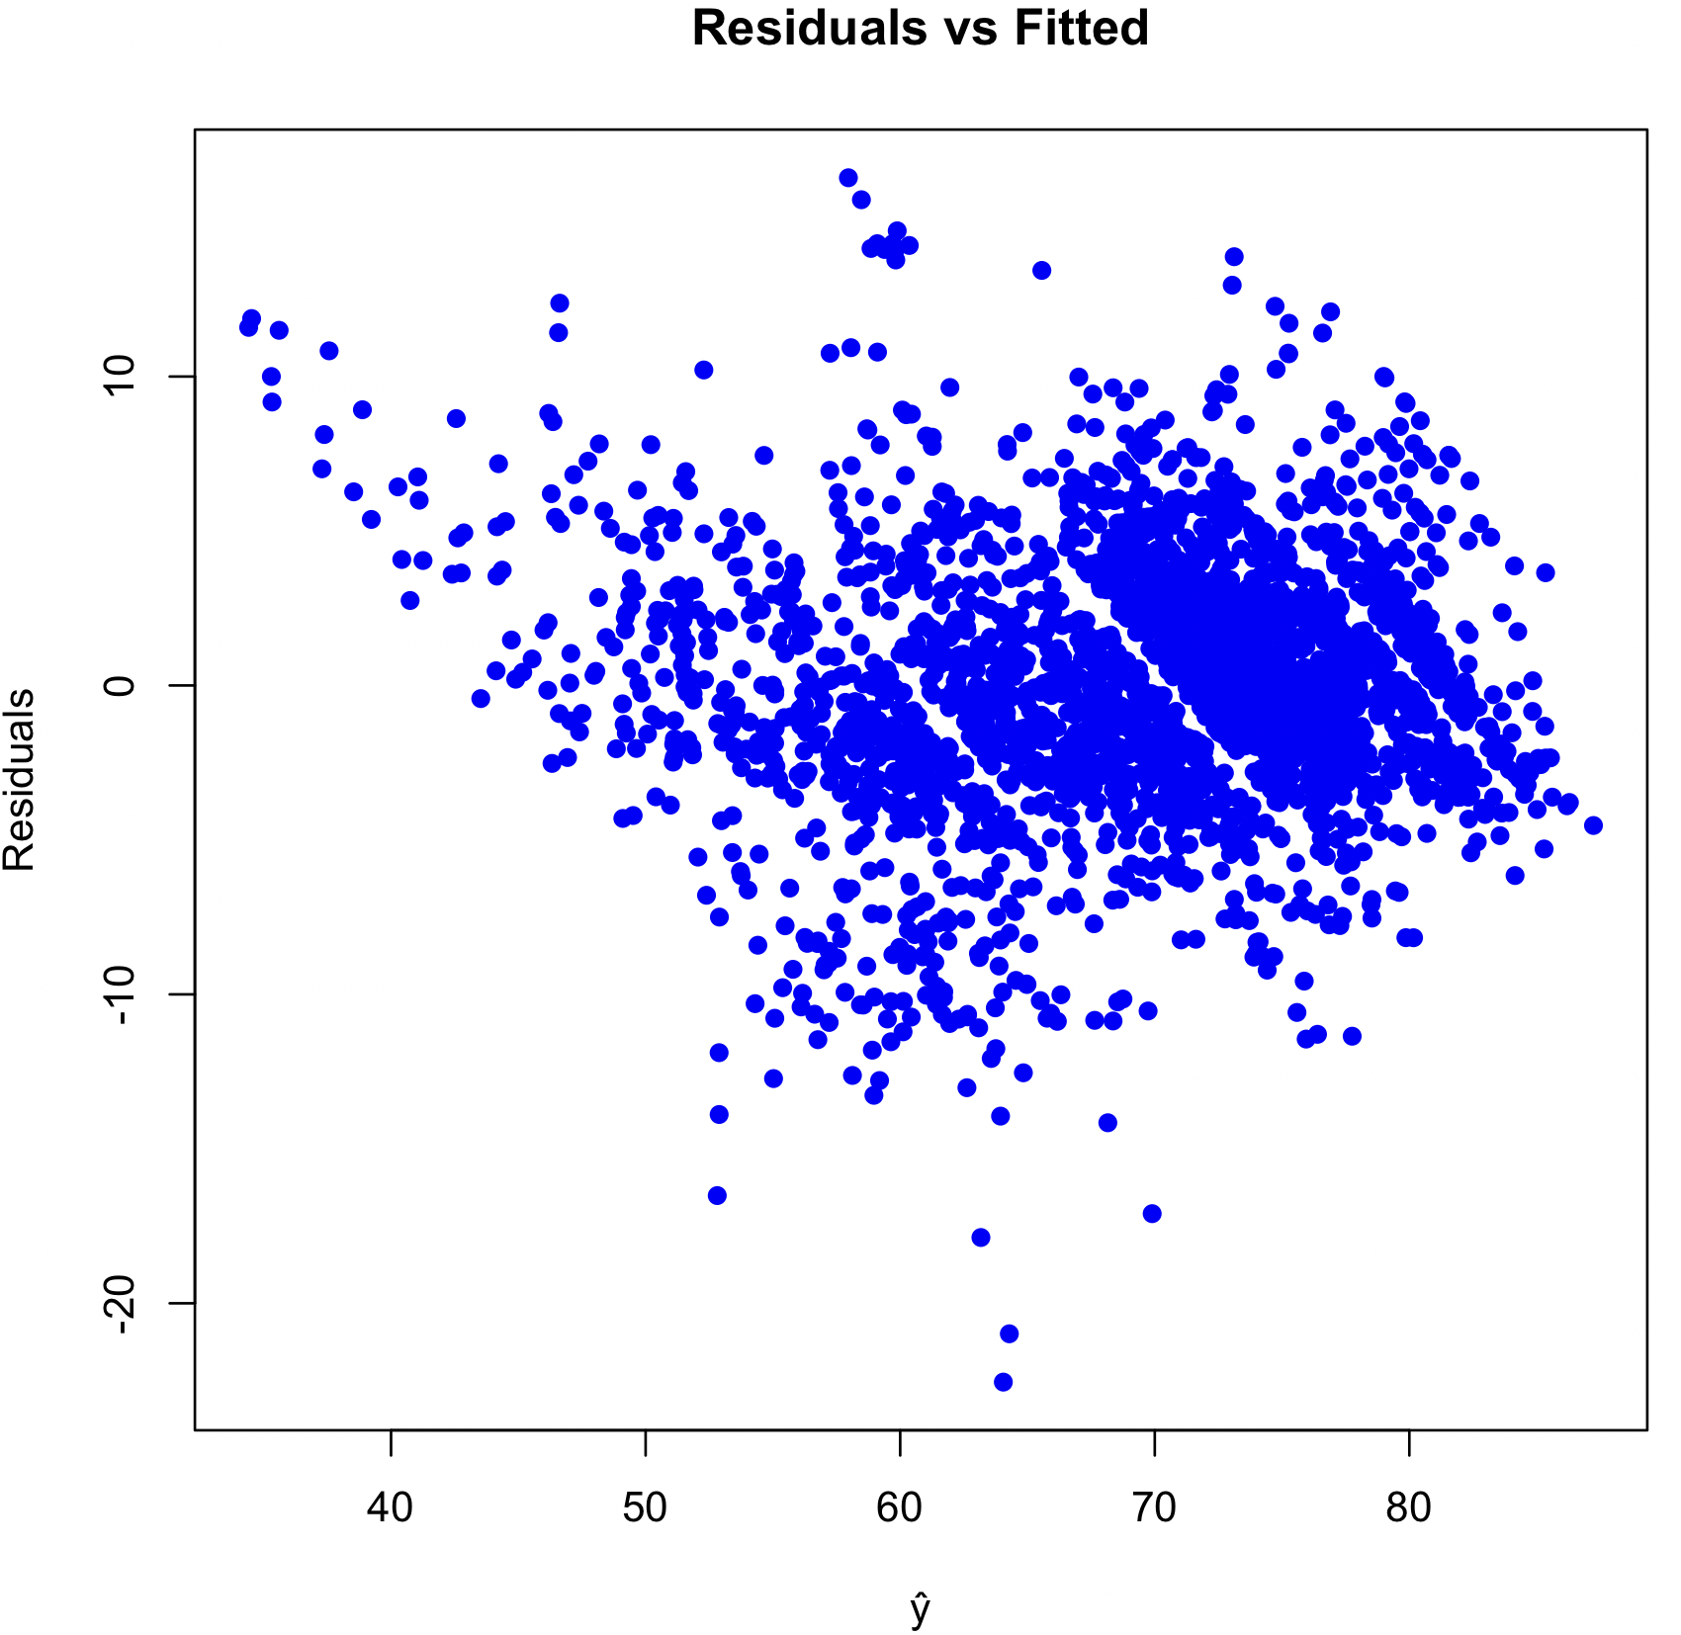
Heteroscedasticity
Not Completely but seems to have a pattern (Double Bow).
So assumed heteroscedasticity.

Slide 7
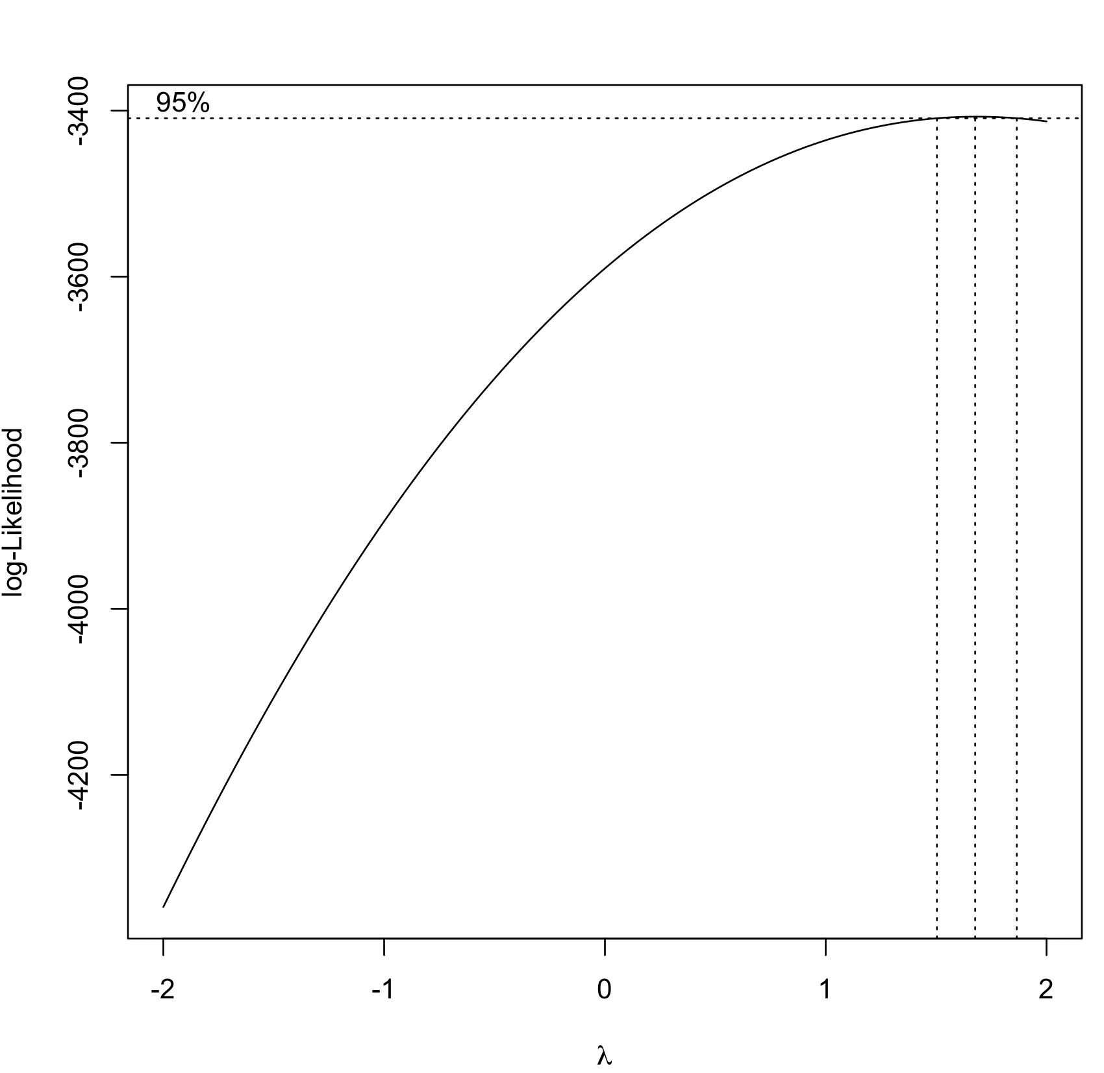
BOXCOX:
λ = 1.6

Slide 8
Transformation:
For heteroscadsticity and boxcox, we applied Y’ =y^1.6
R2adj value of the model is 0.8113
For heteroscadsticity and boxcox, we applied Y’ = y^1.7
R2adj value of the model is 0.8103
Since the R2adj decreased, it indicates that these transformations are not the solution for improving the model.

Slide 9
01
Initially, the full model has some insignificant values, thus removed them.
02
Then checked multicollinearity, and after finding multicollinearity, tried couple of different models, which haven't helped in improving the model.
Conclusion
03
Plotted error vs residuals plot inorder to find heteroscedasticity, even this didn’t help much, so went for box cox.
04
Even after boxcox transformation the model didn't improve much.
04
05
So the final model is the reduced model with R2adj value is 0.8158

Slide 10

Thank You!

